Slide 1
Oral pathology lec.2
Dental caries

Slide 3
Dental caries
Dental caries is defined as a progressive irreversible microbial disease affecting the hard parts of tooth exposed to the oral environment, resulting in demineralization of the inorganic constituents and dissolution of the organic constituent, thereby leading to a cavity formation.

Slide 4
It is a complex, continuous, dynamic biological process of tooth decay with multifactorial etiology.

Slide 6
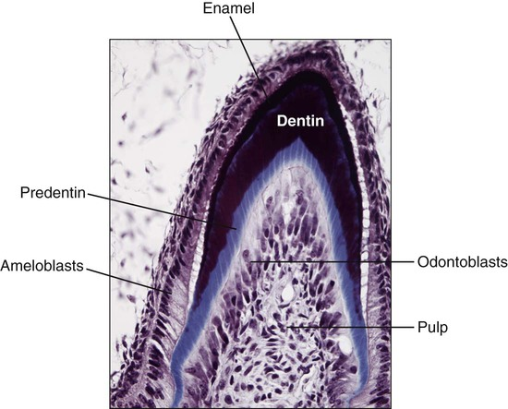

Slide 7
Theories of Etiopathogenesis
Miller’s acidogenic theory
Proteolytic theory
Proteolysis-chelation theory
Sucrose chelation theory.

Slide 8
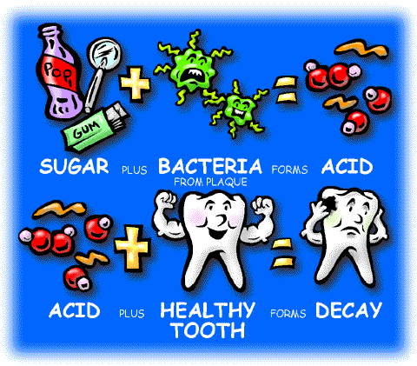

Slide 9
Miller’s acidogenic theory
WD Miller’s chemoparasitic theory states:
“Dental decay is a chemoparasitic process consisting of two stages, the decalcification of enamel, which results in its total destruction and the decalcification of dentin as a preliminary stage, followed by dissolution of the softened residue.”

Slide 10
Factors Responsible for Miller’s Theory
Role of carbohydrates
Role of microorganisms
Role of acids
Role of dental plaque.

Slide 11
Role of carbohydrates
Food act as substrates for microorganisms of dental plaque, which form acids, thereby causing dental caries.
Other substances may affect microflora in negative way thus protecting the tooth from caries.
Carbohydrates is main cause of dental caries. There is considerable increase in caries incidence after exposure of modern civilization to refined foods.

Slide 12
Cariogenicity of Carbohydrate Varies with :
Frequency of ingestion: The risk of caries incidence increases greatly if carbohydrates are taken repeatedly in between two major meals. It provides an almost constant supply of carbohydrate to the plaque bacteria for fermentation and subsequent production of acids.
Chemical composition : The carbohydrates in the form of glucose, sucrose and fructose, etc. rapidly diffuse into the plaque due to their low molecular weight and therefore easily available for fermentation by plaque bacteria; Sucrose is utilized by Streptococcus mutans to synthesize an extracellular insoluble polysaccharide (dextran) with the help of glucosyl transferase enzyme. Dextran helps the plaque to adhere firmly onto the tooth surface and helps a direct contact between the acids liberated by microorganisms and the tooth, thus causing demineralization. Thus, sucrose is most potent cariogenic substance.

Slide 13
Physical form : Sticky, solid carbohydrates are more cariogenic than other forms
Route of administration
Presence of other food constituents

Slide 14
Role of Microorganisms
Caries is caused by acid resulting from action of microorganisms on carbohydrates.
Bacteria that can produce acids, particularly lactic acid, from the substrate of host’s diet and can tolerate very low pH (<5) are suspected of initiating caries.

Slide 15
Localization of oral flura in dental caries
Location | Microorganism
Pit and fissure | Streptococcus mutans
 | Lactobacillus species
Smooth surface caries | Streptococcus mutans
Root caries | Actinomycosis viscosus
 | Actinomycosis naeslundii
 | Other filamentous rod
 | Streptococcus mutans
 | Streptococcus salivarius
 | Streptococcus sanguis
Deep dentinal caries | Lactobacillus species
 | Actinomycosis viscosus
 | Actinomycosis naeslundii
 | Streptococcus mutans Other filamentous rod

Slide 16
Streptococcus mutans:
The role of S. mutans has been proved for the initiation of caries on the following basis:
It increases the amount of sticky plaque as it is capable of producing extracellular polysaccharides.
It generates acid rapidly from sucrose .
It multiply in abundance in low pH plaque thereby colonizing and increasing the plaque bulk.
It provides a favorable substrate for other cariogenic microorganisms.

Slide 17
Progression of dental caries:
The organisms responsible for progression of the lesion are usually present in the advancing front of the dentinal caries.
These are mostly facultative and strict anaerobes in advanced dentinal caries.
Streptococcal species in deep dentinal caries and root caries and Lactobacillus casei and acidophilus in dentin.

Slide 18
Role of acids:
Acids play most important role in the pathogenesis of dental caries.
The pH 5.5 is called critical pH because below this pH demineralization of tooth substance begins.
The rapid fall in pH is mainly due to microorganisms metabolizing food substances and producing acids.
This fall in pH depends upon amount of diffusible carbohydrates, nature of microorganisms and rate of diffusion of microorganism.

Slide 19
The rise in pH is slower and it depends upon ability of saliva to neutralize acids and diffusibility of acids out of plaque.
The acids produced due to enzymatic breakdown of the sugar and the acids formed are chiefly lactic acid and butyric acid.
Other acids which are produced are acetic acid, propionic acid, glutamic acid, aspartic acid.
These acids cause demineralization of inorganic portion (initially enamel and later dentin) and eventually cause tooth decay.

Slide 20
Role of Dental Plaque
Dental plaque is a general term for the diverse microbial community (predominantly bacteria) found on the tooth surface, embedded in a matrix of polymers of bacterial and salivary origin.

Slide 21
The dental plaque is consists of:
Salivary components such as mucin.
Desquamated epithelial cells.
Microorganisms.
Plaque is found on uncleaned tooth surfaces and appears as tenacious, thin film which may accumulate within 24 to 48 hours.

Slide 22
GV Black (1899)defined cariogenic plaque as follows:
”The gelatinous plaque of the caries fungus is a thin, transparent film that usually escapes observation, and which is revealed only by careful search. It is not the thick mass of materia alba found on the teeth, nor is it the whitish gummy material known as sordes, which is often prominent in fevers and often present in the mouth in smaller quantities in the absence of fever.”

Slide 23
The Development of Dental Plaque:
Pellicle formation
Attachment of single bacterial cells(0–4hours)
Growth of bacteria leading to formation of microcolonies(4–24hours)
Microbial succession and co-aggregation leading to increased species diversity concomitant with continued growth of microcolonies(1–14days)
Mature plaque (2 weeks or older).

Slide 24
pellicle: This form is a glycoprotein that is derived from the saliva and is adsorbed on tooth surface and the bacterial colonization takes place (the pellicle serves as a nutrient for plaque microorganisms).
Breaks down in the homeostasis and imbalances in the microflora can occur which predispose a site to disease.

Slide 25
The filamentous organisms grow in long interlacing threads and have the property of adhering to smooth enamel surfaces.
Smaller bacilli and cocci become entrapped in this reticular meshwork.
The adhering property and acidogenic property of streptococci and aciduric property of lactobacilli help in further development of cariogenicity of the dental plaque.

Slide 26
Proteolysis Theory
This theory suggests the role of the proteolysis of the organic components of the tooth as an initial process than the actual demineralization and dissolution of inorganic substances.

Slide 27
Proteolysis Chelation Theory
The proteolytic chelation theory suggests that the caries is caused by simultaneous events of proteolysis and chelation.
Proteolysis is destruction of the organic portion of the tooth by the proteolytic microorganisms.
Chelation is removal of calcium by forming soluble chelates by biologic chelators such as certain citrates, amino acids, phosphatases, tartrates, oxalates and enzymes, etc.

Slide 28
It is postulated that oral bacteria attack organic component of enamel (proteolysis) and that the breakdown products have chelating ability and this dissolves the tooth minerals.
This results in formation of soluble chelates with the minerals of the enamel and thereby decalcifies it at a neutral or even at an alkaline pH(Chelation).

Slide 29
Sucrose Chelation Theory
This theory states that if there is a very excessive concentration of sucrose in the mouth of a caries active individual, there can be formation of complex substances like calcium saccharates and calcium complexing intermediaries, etc. by the action of phosphorylating enzymes. These complexes cause release of calcium and phosphorus ions from the enamel and thereby resulting in tooth decay.

Slide 30
SECONDARY CONTRIBUTING FACTORS IN DENTAL CARIES
Saliva
Salivary flow rate
pH and buffering capacity
Viscosity
Antibacterial substances
Teeth
Structural composition
Morphology
Arrangement in the arch
Presence of dental appliance
Diet
Physical nature
Composition
Hereditary

Slide 31
Saliva
Decrease or lack of salivary secretion results in increased rate of dental caries and rapid destruction of tooth as the cleaning or flushing of the bacterial deposits is hampered.

Slide 32
In saliva, the chief buffer systems are the bicarbonate ions and phosphate ions.
High concentrations of bicarbonate ions neutralize the acids produced by the cariogenic bacteria.
Urea secreted in saliva helps in the formation of ammonia by action of the plaque microorganisms.
Ammonia acts as buffer in maintaining the salivary pH.

Slide 33
Teeth
Teeth are usually susceptible to caries during first 2 years after eruption for completion of calcification after eruption.
Concentration of higher number of minerals in the enamel surface, renders it more resistant to decay.
Hypomineralized and hypoplastic enamel has more incidences of caries.
Increased permeability of the enamel surface increases the risk of the caries activity.

Slide 34
Teeth which have high percentage of fluoride are more resistant to caries process.
Pits and narrow fissures allow retention of food debris and thus are prone to development of decay. These areas are also not easily approachable to routine oral hygiene practices.
The most susceptible permanent teeth are the mandibular first molars followed by the maxillary first molars and the mandibular and maxillary molars.

Slide 35
Classification:
Clinical classification
Anatomical classification
Nature of attack
Progression of caries
Based on tissue involved

Slide 37
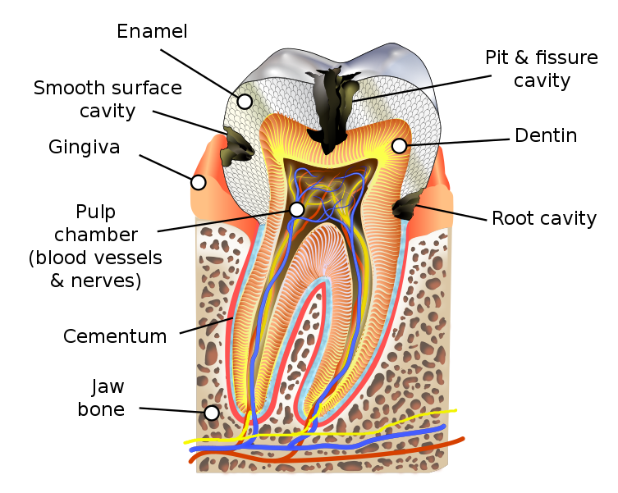

Slide 38
Clinical classification of caries
According to the stage of lesion progression:
Noncavitated lesion
Cavity.
According to the severity of the disease:
Acute caries(active)
Chronic caries (slowly progression)
Stabilized caries (arrested).
According to clinical manifestation:
• White spot lesion :macula caroisa
• Superficial caries: Caries superficialis
• Medium caries: Caries media
• Deep caries: Caries profunda
• Secondary caries: Caries secundaria.

Slide 39
Anatomical Classification of Caries
According to anatomical depth of the defect:
• Enamel caries
• Dentin caries
• Cementum caries
According to location of the lesion:
• Pit and fissure caries – Occlusal
–Buccal or lingual pit
• Smooth surface caries – Proximal
– Buccal or lingual surface
• Root caries
According to intensively of caries within the dentition:
• Single lesion • Multiple lesions • Systemic destruction.

Slide 40
Depending on Nature of Attack
• Primary caries (Incipient, initial): First attack on tooth surface
• Secondary caries (Recurrent): Caries occurring at the margins or walls of existing restorations.

Slide 41
depending on the Progression of the Caries
• Acute: It rapidly invading process that involves several teeth. Lesions are soft and light colored. Usually pulp is involved at the early stage.
– Rampant caries
– Nursing bottle caries
– Radiation caries.
• Chronic: These lesions are long standing and fewer in number.

Slide 42
Smooth surface caries:
Proximal Caries:
It takes 3 to 4 years to manifest clinically as loss of enamel transparency resulting in opaque chalky region (white spot).
Spots are located on the outer surface of enamel between contact point and height of free gingival margin.

Slide 43
The caries penetrates the enamel, the enamel surrounding the lesion assumes bluish white appearance which is usually apparent as laterally spreading caries at the dentinoenamel junction.
Caries does not initiate below free gingival margin.

Slide 44
Cervical, Buccal, Lingual or Palatal Caries:
It usually extends from the area opposite the gingival crest occlusally to the convexity of the tooth surface. It extends laterally towards the proximal surfaces and on occasion extends beneath the free margin of the gingiva.
It usually occurs in cervical area and the typical cervical lesion is a crescent shaped cavity beginning as slightly roughened chalky area which gradually becomes excavated.

Slide 45
Histopathology of smooth surface caries:
Enamel Changes :
The earliest changes are loss of the inter-prismatic or interrod substance of enamel with increased prominence of the rods.
The roughening of the ends of the enamel rods, suggest that the prisms may be more susceptible to early attack.
Another change in early enamel caries is the accentuation of the incremental striae of Retzius.

Slide 46
Enamel consists of crystals of hydroxyapatite packed tightly together in orderly arrangement. Each crystal is separated from its neighbors by tiny intercrystalline spaces or pores. The spaces are filled with water and organic material. When enamel is exposed to acids produced by dental plaque, minerals is removed from the surface of the crystals which shrinks in size. The intercrystalline spaces enlarge and the tissue becomes more porous. “At this stage the carious lesion can be detected clinically and called white spot lesion “.

Slide 47
Ultrastructural studies suggest preferential dissolution initially along prism boundaries, but there is also a diffuse demineralization with an increase in intercrystallite distance affecting areas both within and between the prisms. These intercrystallite spaces presumably reflect the variation in pore volume in different areas of the lesion; changes in crystal structure are thought to be due to both demineralization and reprecipitation of mineral.

Slide 48
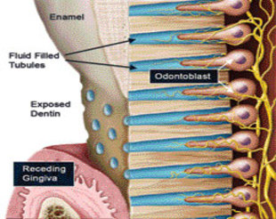

Slide 49
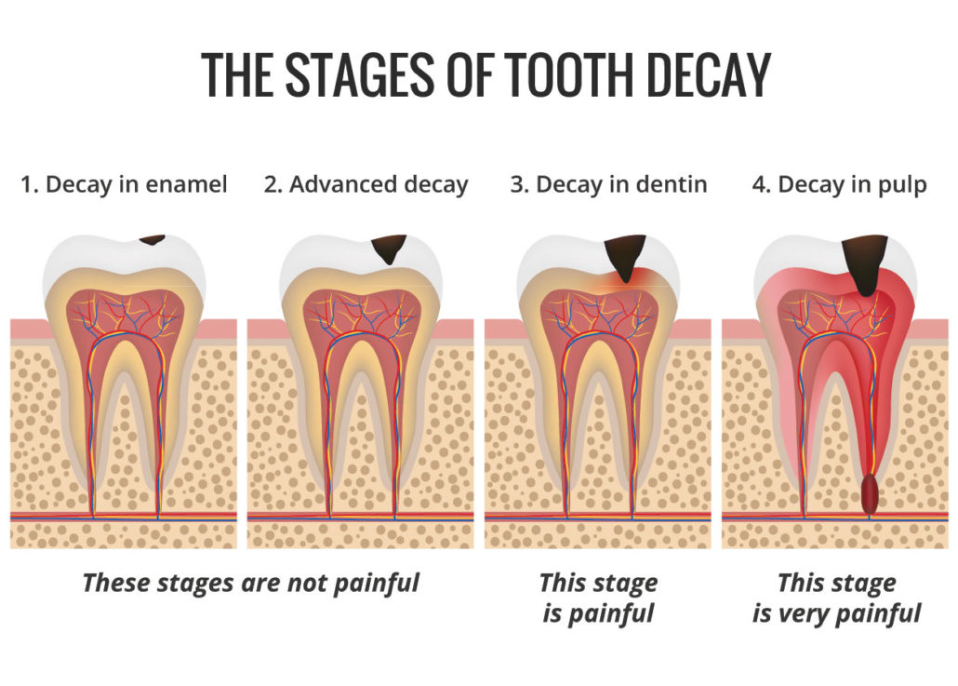

Slide 50
As the process advances and involves deeper layers of enamel, it will form triangular or actually a cone-shaped lesion with apex towards the dentinoenamel junction and the base towards the surface of the tooth.

Slide 51
Enamel feels rough to hand in advanced caries which may be due to disintegration of the enamel prisms after decalcification of the inter-prismatic substance and the accumulation of debris and microorganism over the enamel rods

Slide 52
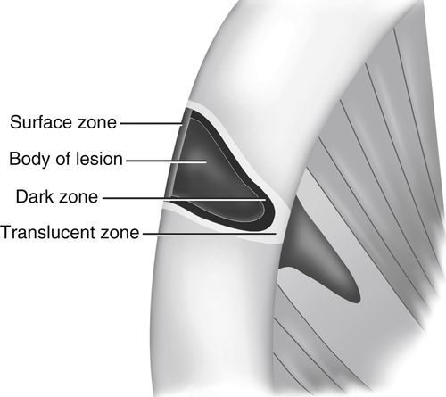

Slide 53
Enamel changes
Zone 1: The translucent zone lies at the advancing front of the enamel lesion. By use of polarized light ; this zone is slightly more porous than sound enamel.
Zone 2: The dark zone lies adjacent and superficial to the translucent zone. It has been referred to as positive zone because it is usually present. This zone is present as a result of demineralization.
Zone 3: The body of the lesion lies between the relatively and the accumulation of debris and micro-organism over the enamel rods.
Zone 4: The surface zone, when examined by polarizing light appears relatively unaffected.

Slide 54
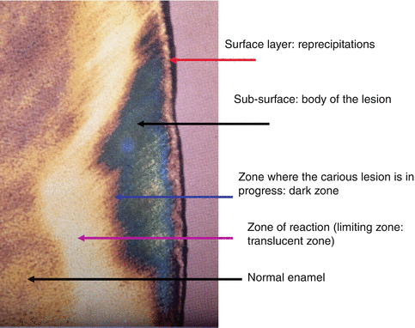

Slide 55
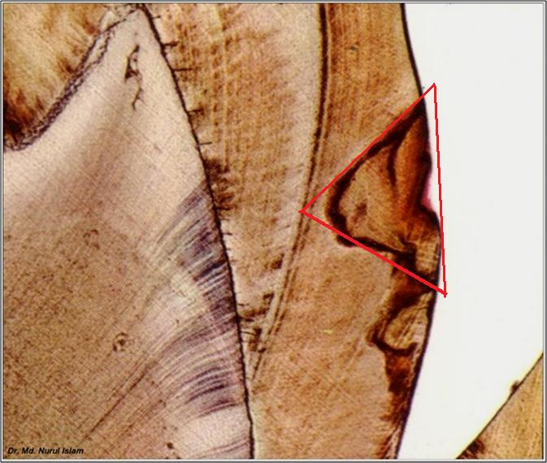

Slide 56
Dentin Changes
The initial penetration of the dentin by caries may result in alteration in the dentin called as ‘dentinal sclerosis’.
Dentinal sclerosis is a reaction of vital dentinal tubules and a vital pulp in which there results a calcification of the dentinal tubules which finally seals them against further penetration by microorganisms

Slide 57
The initial decalcification involves the walls of the tubules allowing them to distend slightly as they become packed with masses of microorganisms.
The decalcification of the walls of the individual tubules leads to their confluence.
A thickening and swelling of the sheath of Neumann at irregular intervals along the course of the involved dentinal tubules.
Increased diameter of the dentinal tubules due to packing of the tubules by microorganisms.

Slide 58
Tiny Liquefaction foci are formed by focal coalescence and breakdown of a few dentinal tubules. This ‘focus’ is an ovoid area of destruction parallel to the course of the tubules and filled with necrotic debris which tends to increase in size by expansion. This produces compression and distortion of adjacent dentinal tubules so that their course is bent around the liquefaction focuses.

Slide 59
Zones of Dentine changes:
Zone 1: Zone of fatty degeneration of Tomes fibers.
Zone 2: Zone of dentinal sclerosis characterized by deposition of calcium salts in dentinal tubules.
Zone 3: Decalcification of dentin, a narrow zone preceding bacterial invasion.
Zone 4: Zone of bacterial invasion of decalcified but intact dentin.
Zone 5: Zone of decomposed dentin.

Slide 60
PIT AND FISSURE CARIES
It is also called occlusal caries.
It is primary type and develops in the occlusal surface of molars and premolars.
Deep narrow pits and fissures favor the retention of food debris and microorganisms and caries may result due to fermentation of this food and the formation of acids.
It appears brown or black and will feel slightly soft and catch a fine explorer point.
The lateral spread of caries at the dentinoenamel junction as well as penetration into the dentin along the dentinal tubules may be extensive without fracturing away the overhanging enamel. Thus, there may be large carious lesion with only a tiny point of opening

Slide 61
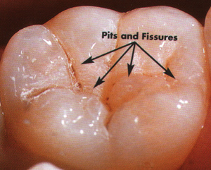

Slide 63
In other words….
The tooth enamel (outer layer of crown) is very hard and doesn't dissolve easily even with acids, but the underlying dentin dissolves easily with lactic acid eventually a cavity is formed in the dentin below the enamel , when the cavity is large enough, the enamel will crack, exposing the dentin, bacteria find the dentin a rich environment for growth and quickly eat through the dentin into the underlying pulp.

Slide 64
Histopathological Features
Enamel changes:
They are more or less same as smooth surface caries.
Enamel at the bottom of the pit or fissure may be very thin so that early dentin involvement can occur.
Enamel rods flare laterally at the bottom of the pits and fissures.
Lesion forms a triangular or cone-shaped lesion with its apex at the outer surface and its base toward the dentinoenamel junction.

Slide 65
In others words….
At the first, the decalcified dentin retains its normal morphology and no bacteria can be seen.
Once the dentine has been reached, pioneer bacteria extend down the tubule, soon fill them and spread along any lateral branches.
The tubules become distended into spindle shapes by the expanding masses of bacteria and their product, as a result, adjacent tubule which are less heavily infected become bent, later the intervening tubule wall are destroyed and collections of bacteria in adjacent tubule coalesce (united) to form irregular liquefaction foci (these are ovoid areas of dentinal destruction and it is parallel to the direction of dentinal tubule. It is filled with necrotic debris which increases gradually in size by expansion; in some areas, bacteria also spread laterally and occasionally large bacteria filled, clefts formed at right angles to the tubules. Clinically, these clefts may allow carious dentin to be excavated easily.

Slide 66
1.Zone of fatty degeneration of protoplasmic process: effect of bacterial enzyme on the cell membrane of the organic component.
2- Zone of dentinal sclerosis (translucent zone): regarded as vital reaction of odontoblast to irritation (deposition of calcifying salts from the demineralized zone).
3- Zone of decalcification: soft dentin due to the action of bacterial enzyme
4- Zone of bacterial invasion.
5- Zone of decomposition of dentin: cavitation (become no mineralized remain and the organic component dissolved by the bacteria).

Slide 67
ROOT CARIES
It is also called cemental caries and involves both dentin and cementum.
Exposed root are more vulnerable to an acid attack because of higher porosity and smaller crystal.

Slide 68
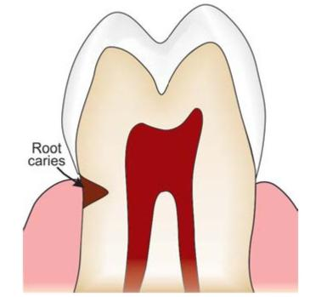

Slide 69
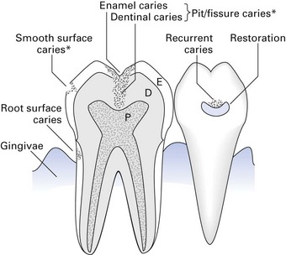

Slide 70
Histopathological Features
It is a soft progressive lesion that is found anywhere on the root surface that has lost connective tissue attachment and is exposed to the oral environment.
Microorganisms appear to invade the cementum either along Sharpe’s fibers or between bundles of fibers, in a manner comparable to the invasion along dentinal tubules.
As cementum is formed in concentric layers and presents a lamellated appearance, the microorganisms tend to spread laterally between the various layers.
The carious lesion assumes the shape of a saucer
After decalcification of cementum destruction of the remaining matrix occurs similar to the process in dentin.

Slide 71
Rampant Caries
It is defined as a suddenly appearing, widespread, rapidly burrowing type of caries, resulting in early involvement of the pulp and affecting those teeth usually regarded as immune to ordinary decay. Some believe that the term rampant caries should be applied to those carious lesions with 10 or more new lesions per year.
It may occur due to nutritional deficiency, malnutrition, emotional disturbances

